Slide 1
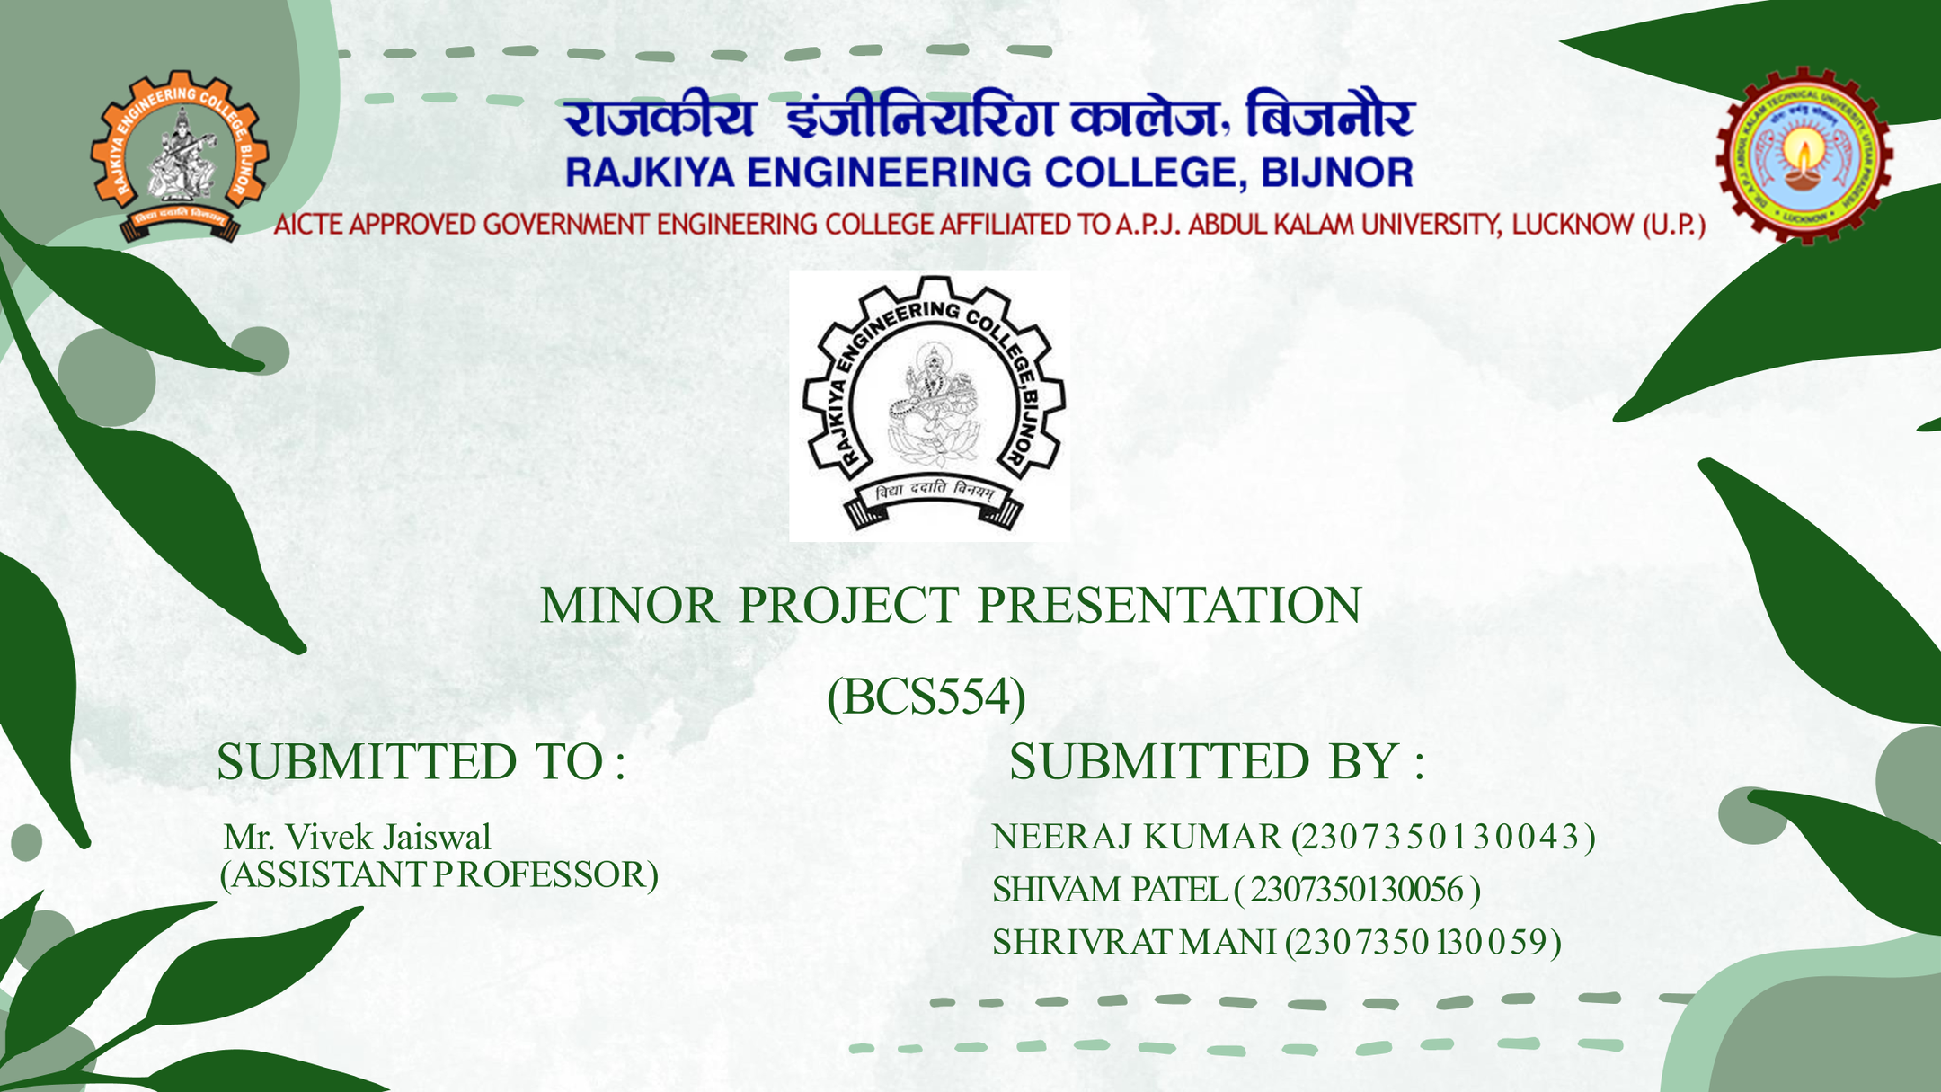

Slide 2


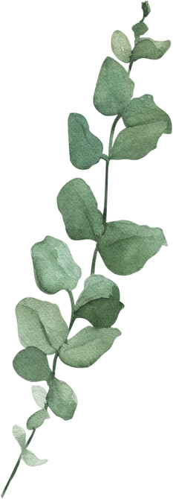




Problem Statement
Low-light images have serious quality issues, they appear too dark to understand and important details are lost or hidden.

Slide 3
Objective
To brighten low-light images naturally.
To prevent details such as edges and textures.
To reduce noise with minor blurring of images.
To improve color quality and make the image look realistic.
To create an easy-to-use web application for enhancement using Streamlit.

Slide 4
Proposed Solution
1. Use MIRNet Model:
MIRNet is a deep-learning architecture designed for image enhancement.
2. Processing:
Brightens dark areas
Removes noise
Restores color and detail
3. User Interface
A Streamlit web app allows Uploading low-light images and Enhancing them with one click as well as Downloading the improved image.

Slide 5

Methodology
Data Collection
Data Preprocessing
Model Training
Application Development
Model Integration
Model Saving
Output Result

Slide 6
System Flow
Input Low-Light Image
Preprocessing
Feature Extraction
Reconstruction
(Decoder / Conv)
Spatial Attention Block
Selective Kernel Feature Fusion
Enhanced Output Image

Slide 7
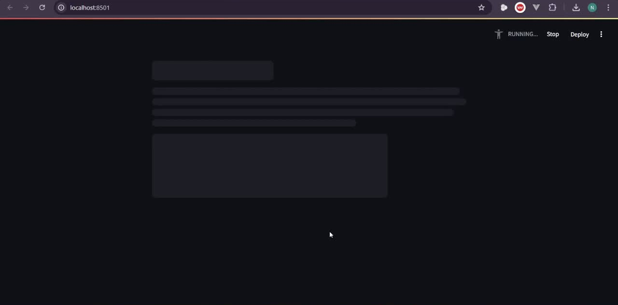
Demo Video

Slide 8
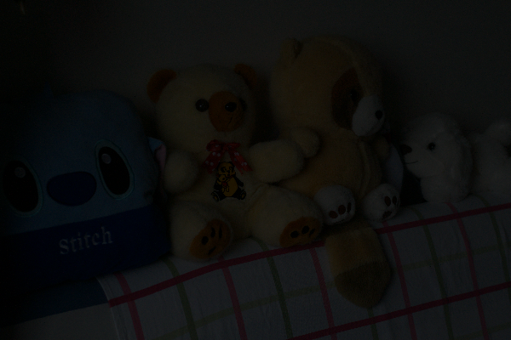
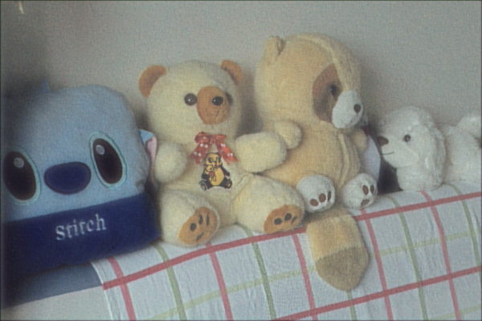

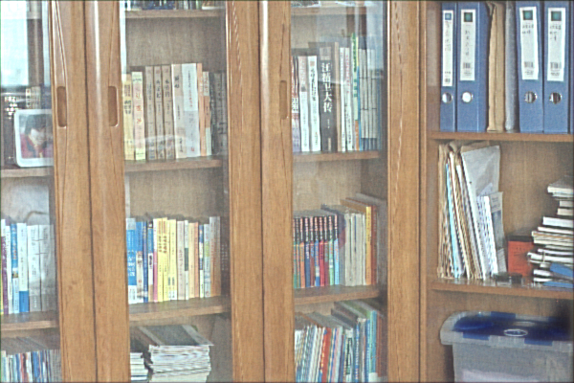
Comparison
Real Image
Enhanced Image

Slide 9
Result
The project produces:
a) Brighter Images
Visibility is significantly improved.
b) Cleaner Images
Noise is reduced with minor blurring in images.
c) Better Colors
Colors appear natural and consistent.
d) Clearer Details
Edges, textures, and objects become more visible.
e) Real-Time Output
Enhancement happens quickly through the web app.

Slide 10
Conclusion
MIRNet proves to be highly effective in enhancing low-light images.
It solves the limitations of traditional enhancement techniques.
The project successfully provides a practical and user-friendly solution.
The final system demonstrates how deep learning can improve real-world visual problems.

Slide 11
Thank You

